Slide 1
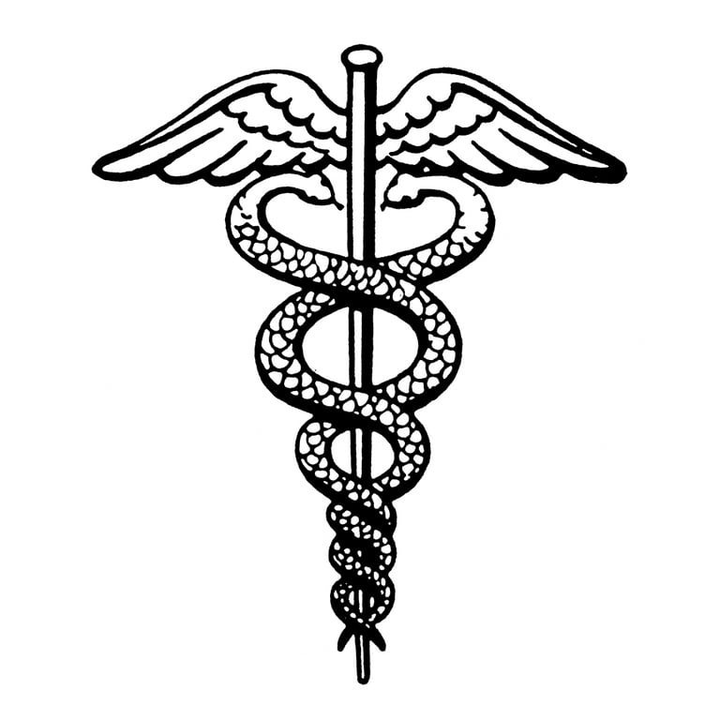


Roles Team leaders : Xavier Di Marco, Jayden Trujillo
Team researchers : Justin Sookraj, Adriano Baltazar
Team Presenters : Jonthan Wright, Caleb McCord

Slide 2
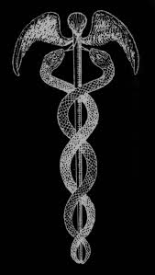
OUTLINE
History of HIPAA before and after the act was instated
Case laws
Consequences of Breaking HIPAA guidelines
The impact when HIPAA was instated
Potential Improvements
Conclusion
Resources

Slide 3

History
HIPAA stands for Health Insurance Portability and Accountability Act.
HIPAA was passed on August 21, 1996.
HIPAA is a law that adds practices that addressed how people's health information should be disclosed.
What made HIPAA necessary was a need for more portable insurance and previous breaches of Protected Health Information(PHI).
Years after HIPAA was originally passed there were updates and additional rules added.
The HIPAA Privacy Rule and the Security Rule both became effective immediately apart from certain companies.

Slide 4

Case Law
HIPAA violation cases in 2024:
Montefiore Medical Center fined $4.75 million for "Malicious Insider" breach that leaked patient's medical info.
Green Ridge Behavioral Health filed a $40,000 report after 14,000 patient records were breached.
Essex Residential Care fined $100,000 for HIPAA violation for not providing patient records to son.
The privacy rule in HIPAA prevents patient's medical care information from being publicly leaked
The statute also states that patients are entitled to the proper documents about the results of the health procedure

Slide 5

Law/Consequences
Consequences are being charged a fine of $50,000 and 1 year of imprisonment.
HIPAA allows for civil monetary penalties of up to $1.5 million per year maximum.
Protects all medical records and other health information.
Ensures confidentiality, integrity and availability of PHI(protected health information).
Protects and safeguards any unwanted threats that may want to steal information.

Slide 6

Impact
Due to this law, many impacts on society occurred, including:
Patient Recruitment was heavily reduced.
Patients were allowed more power in their medical health information.
Research became more expensive as paper and other resources became more necessary.
IRB (Institutional Review Boards) interpretation variations caused multisite trials to be more difficult.
HIPAA helped reduce Fraud (By covering entities such as healthcare providers and health plans to better help identify fraud).

Slide 7

Potential Improvements
HIPAA can be improved by mapping patient data flow to prevent breaches.
Organizations can secure data by creating policies for access, storage, transfer, and disposal.
Making a recovery plan to recover or restore in case of an emergency.
Make more efficient processes to not mismatch a patient's data.
Having patients access their electronical health records.

Slide 8

Conclusion
HIPAA was created originally made to make dealing with healthcare and insurance easier.
To allow people the ability to change their insurance company they gave hefty fines to whoever didn't follow the law.
The consequences were things like a year of prison or a $50,000 fine.
This law led to different things happening.
These were things like patient recruitment time being reduced, research being more expensive, and more errors in research.
HIPAA had several positive impacts.
It caused things like less breaches of patient's data, organizations having more secure data, and risk assessments to help find vulnerabilities in protecting ePHI.

Slide 9


Resources
https://www.ada.org/en/resources/practice/legal-and-regulatory/hipaa/penalties-for-violating-hipaa#:~:text=According%20to%20the%20U.S.%20Department,up%20to%20one%2Dyear%20imprisonment
https://www.ncbi.nlm.nih.gov/books/NBK9584/#:~:text=The%20most%20common%20effects%20of,4)%20increased%20the%20number%20of
https://www.law.cornell.edu/cfr/text/45/164.308
https://www.hhs.gov/hipaa/for-professionals/security/index.html

